Slide 1

AutomateExcel
Sole Developer: Dylan Phillips,
Sales Operations Intern at TAARCOM, Inc.
Slides created 7/26/2023
All images in this slideshow are for presentation purposes only. Please do not repost or share any of these images, as they are property of TAARCOM, Inc.
Thank you.

Slide 2
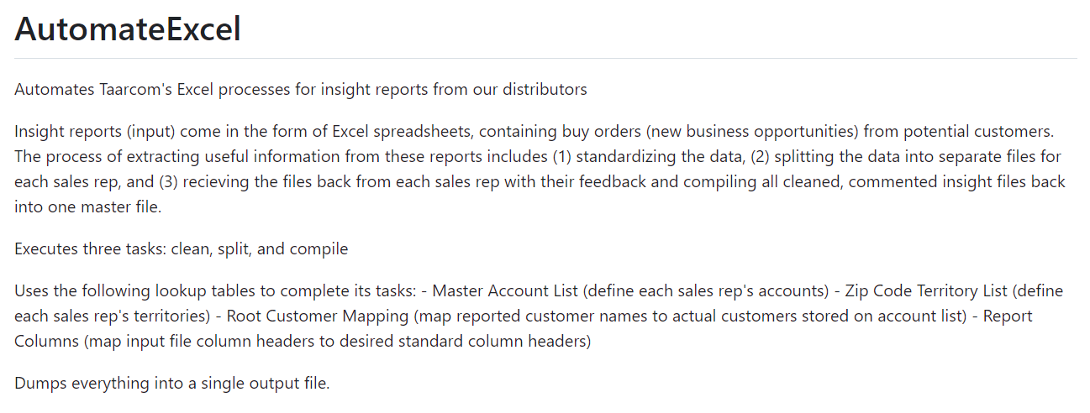

Slide 3
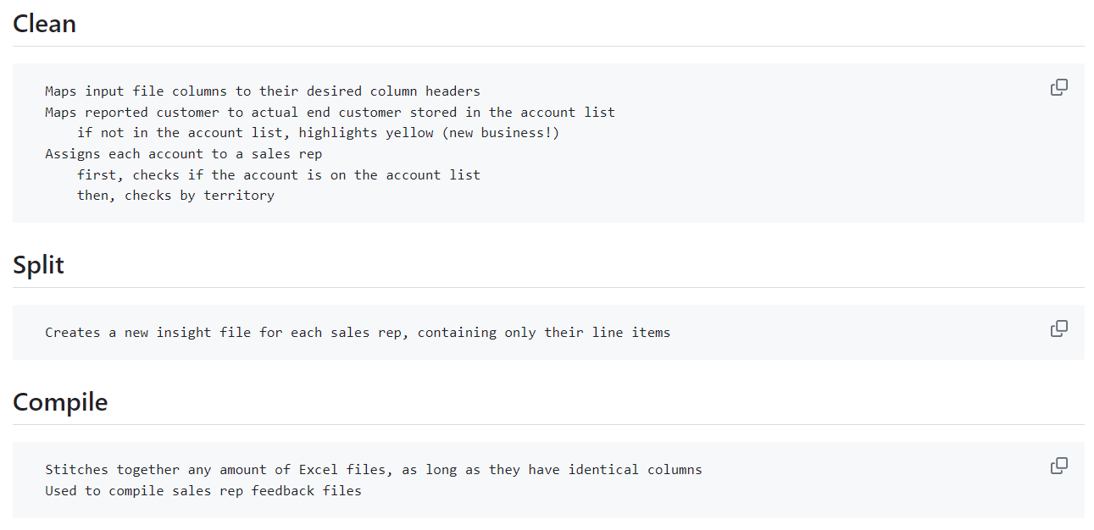

Slide 4
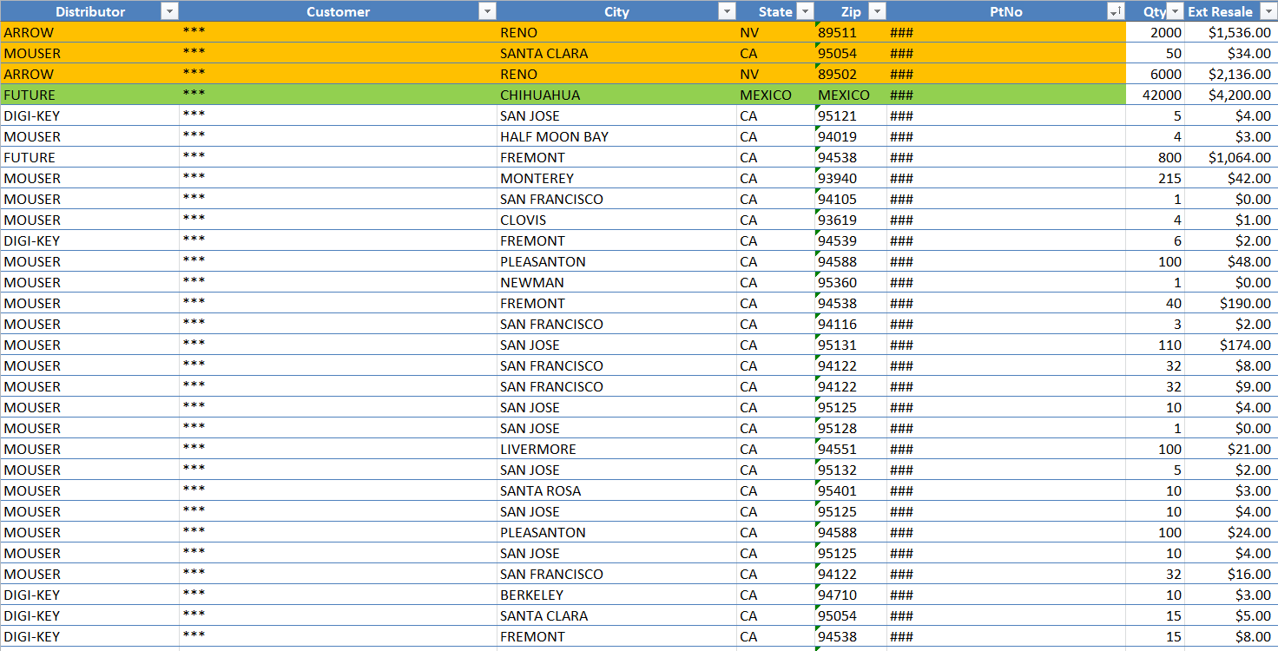
Input File

Slide 5
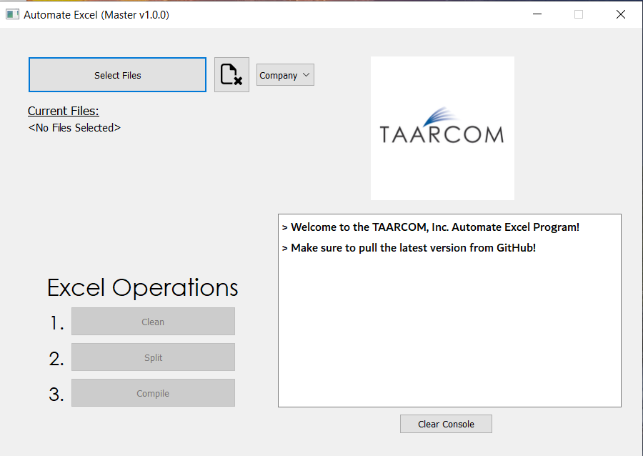
Launch

Slide 6
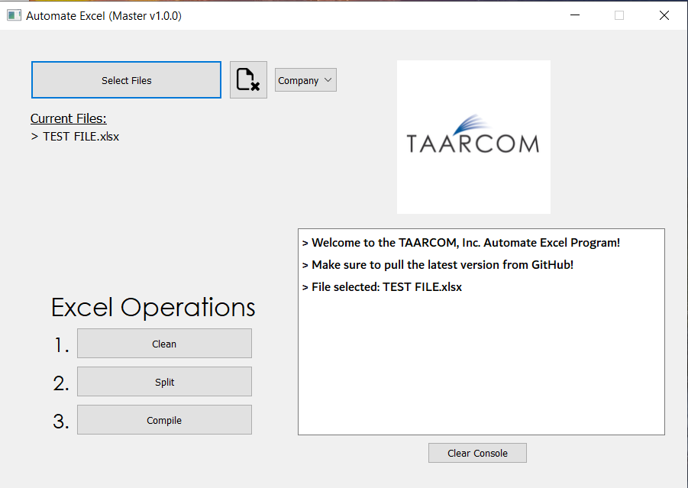
Select File

Slide 7
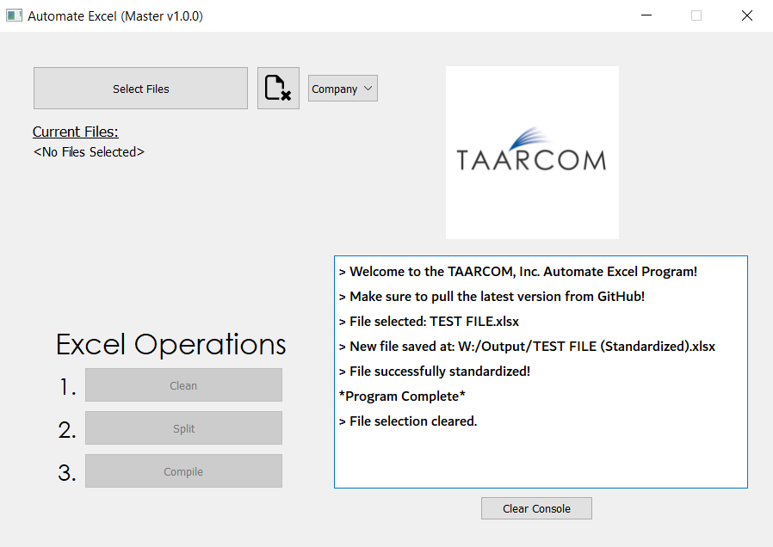
Clean

Slide 8
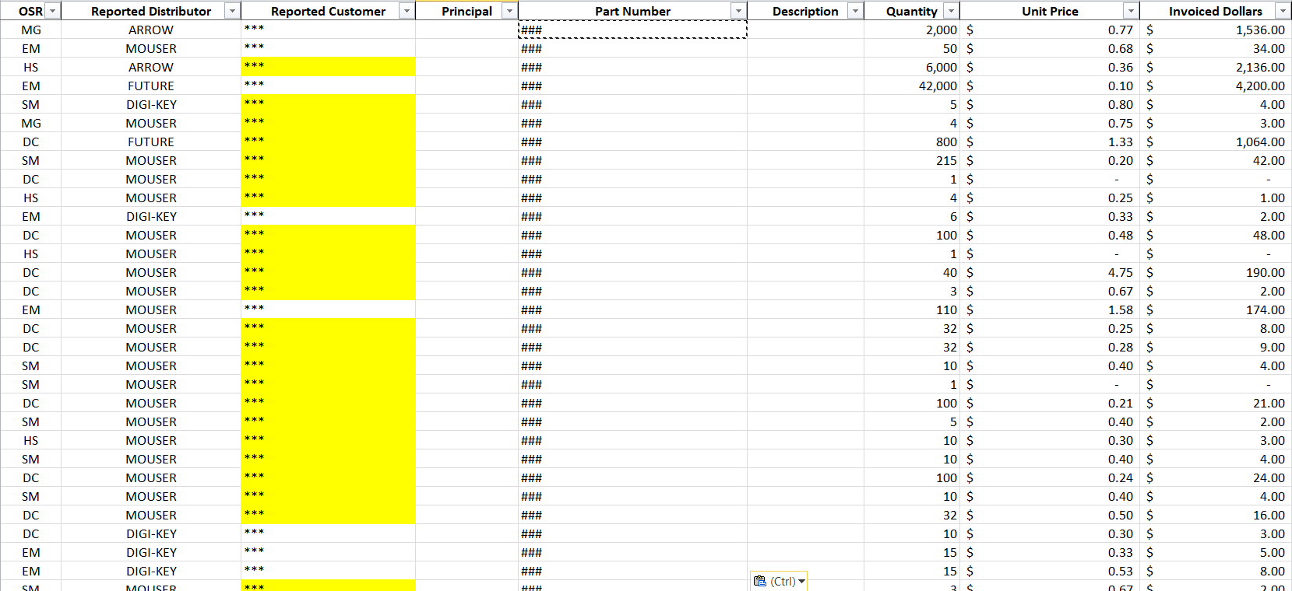
Clean Output

Slide 9
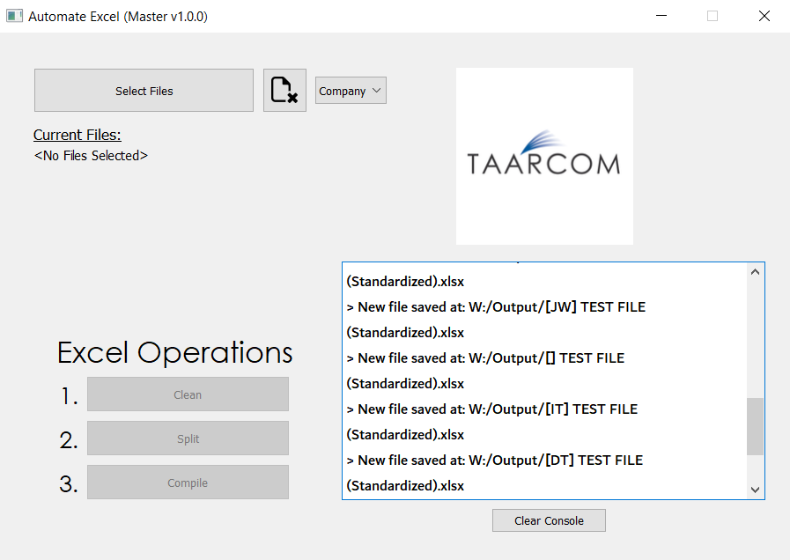
Split

Slide 10
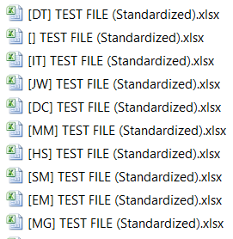
Split Output

Slide 11
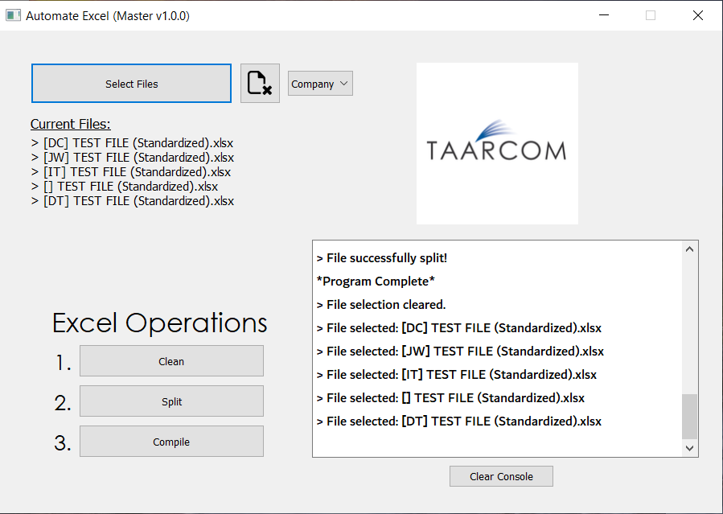
Select (Compile) Files

Slide 12
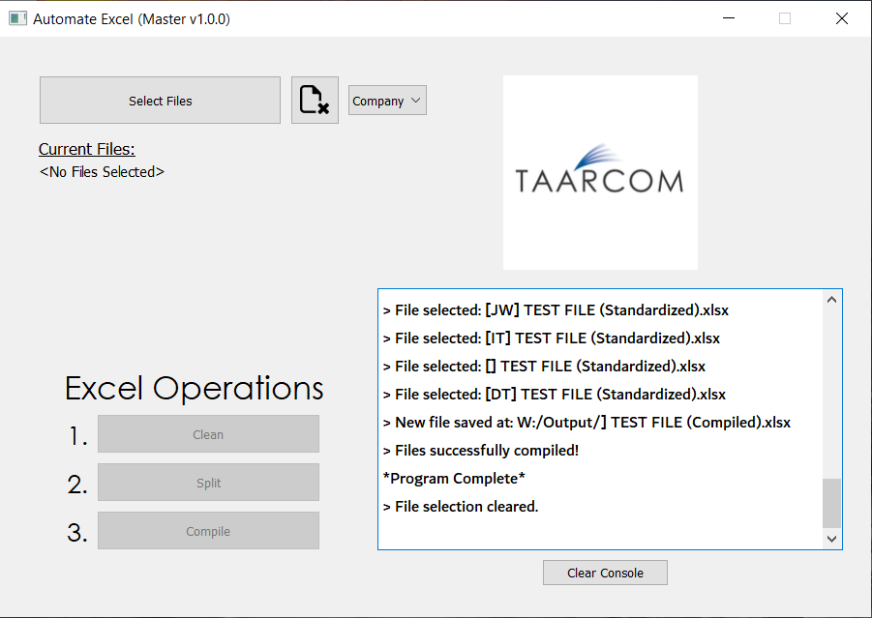
Compile

Slide 13
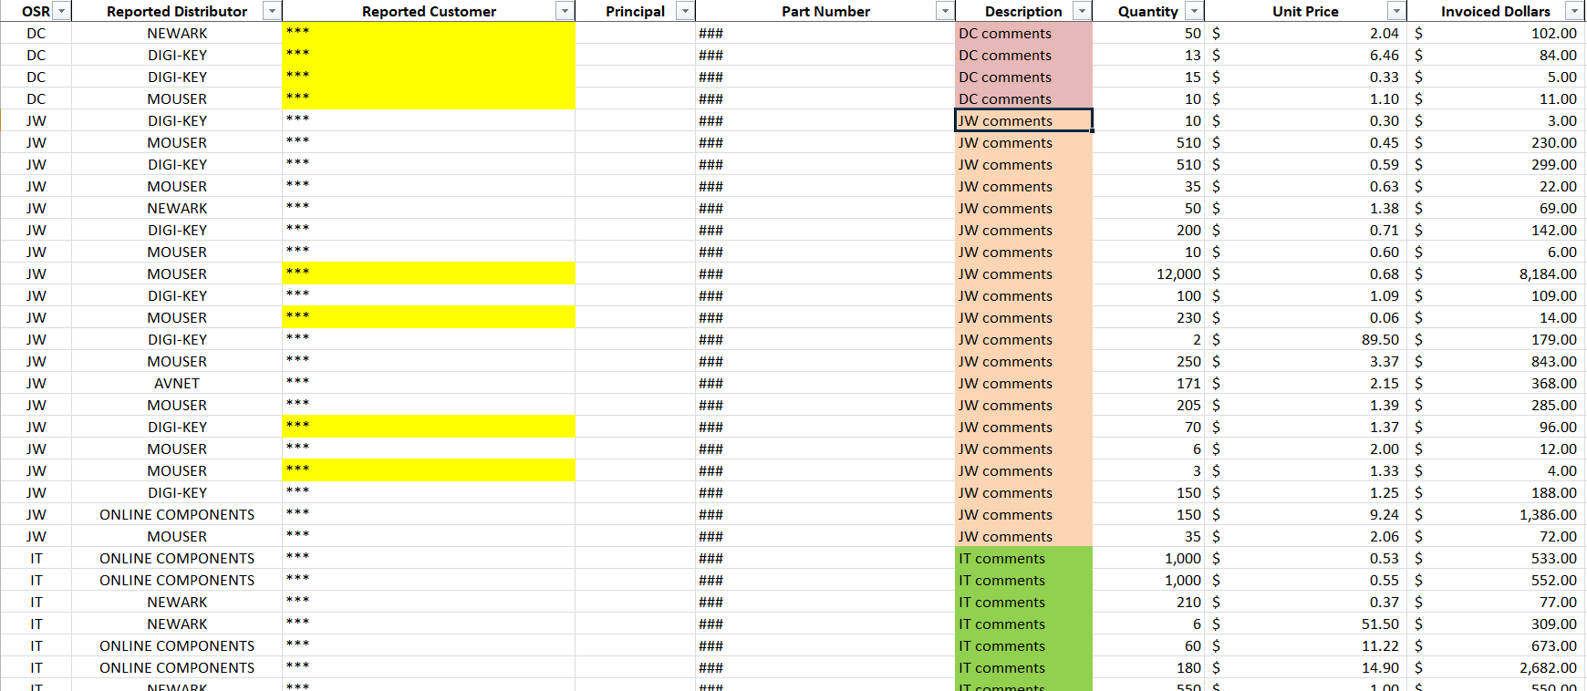
Compile Output

